Slide 1




First Steps in PHP
Creating Very Simple PHP Scripts
PHP
SoftUni Team
Technical Trainers
Software University
http://softuni.bg

Slide 2


Table of Contents
What is PHP?
First PHP Script: Hello PHP
Variables, Conditions, Loops
Loops: Numbers 1 to 20
Generate Color Palette
HTML Forms with PHP
Hello, Person
Sum Two Numbers

Slide 3
Have a Question?
sli.do #3769

Slide 4

What is PHP?
PHP (PHP Hypertext Preprocessor)
Server-side scripting language for building dynamic Web sites
PHP code is embedded in HTML pages
Rendered to HTML at the Web server
This is HTML code
<ul>
<?php for($i = 1; $i <= 20; $i++) { ?>
<li><?= $i ?></li>
<?php } ?>
</ul>
This is PHP code

Slide 5

Problem: Hello PHP
Write PHP script to print "Hello PHP!"
hello.php
<?php
echo "Hello, PHP!";
?>
Check your solution here: https://judge.softuni.bg/Contests/Practice/Index/235#0

Slide 6
Variables in PHP
Variables in PHP are prefixed by $, e.g. $count
Not declared, created at first assignment
Variables have type, but it is not explicitly specified
echo $count; // Notice: Undefined variable: count
$count = 20; // variable $count, value 20 (integer)
echo $count . ' <br>'; // 20 <br>
echo gettype($count); // integer
var_dump($count); // int 20

Slide 7


Variables in PHP (2)
Checking whether a variable exists
isset(variable)
Deleting an existing variable
unset(variable)
$count = 20;
if (isset($count))
echo $count; // 20
unset($count);
echo $count; // Notice: Undefined variable: count

Slide 8
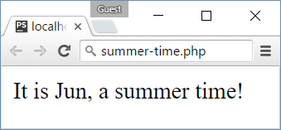
Conditions in PHP
PHP supports if-else and switch-case like C#, Java and JS
<?php $month = intval(date("m")); ?>
<?php if ($month >= 6 && $month <= 8) { ?>
<p>It is <?=date("M")?>, a summer time!</p>
<?php } else { ?>
<p>Sorry, not summer.</p>
<?php } ?>

Slide 9
Loops in PHP
PHP supports while, do-while, for and foreach loops
$count = 1;
while ($count <= 10) {
echo "<p>$count</p>";
$count++;
}
$i = 10;
do {
echo $i . "<br>\n";
$i--;
} while ($i > 0);
for ($i=0; $i<9; $i++) {
echo "<div>$i</div>";
}
$nums = array(1, 2, 3);
foreach ($nums as $x)
echo $x . "<br>";

Slide 10
Problem: Numbers 1 to 20
Write a PHP script to print the numbers from 1 to 20
Print the numbers in a list <ul><li>…</li></ul>
Print odd lines in blue, even lines in red
<ul>
<li><span style='color:blue'>1</span></li>
<li><span style='color:green'>2</span></li>
<li><span style='color:blue'>3</span></li>
…
</ul>

Slide 11
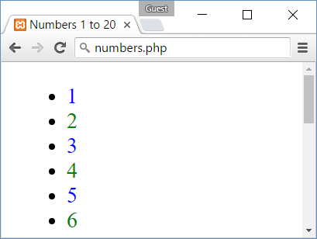
Solution: Numbers 1 to 20
<ul>
<?php
for ($i = 1; $i <= 20; $i++) {
if ($i % 2 == 0)
$color = 'green';
else $color ='blue';
echo "\t<li><span style='color:$color'> $i</span></li>\n";
} ?>
</ul>
Check your solution here: https://judge.softuni.bg/Contests/Practice/Index/235#1

Slide 12
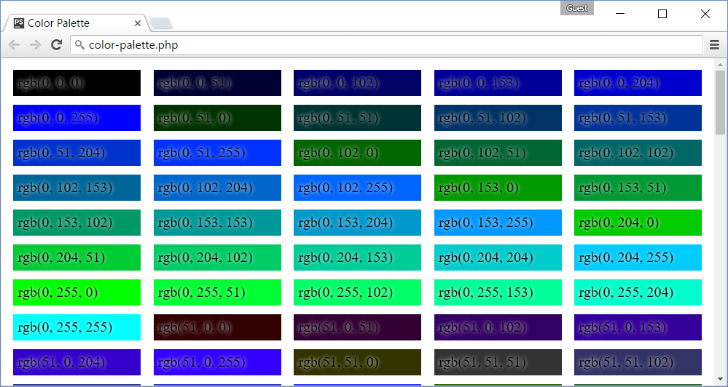
Problem: Color Palette
Write a PHP script to print a color palette like shown below:
<div style='background:rgb(0, 0, 0)'>rgb(0, 0, 0)</div>
<div style='background:rgb(0, 0, 51)'>rgb(0, 0, 51)</div>
…
<div style='background:rgb(0, 0, 255)'>rgb(0, 0, 255)</div>
<div style='background:rgb(0, 51, 0)'>rgb(0, 51, 0)</div>
<div style='background:rgb(0, 51, 51)'>rgb(0, 51, 51)</div>
<div style='background:rgb(0, 51, 102)'>rgb(0, 51, 102)</div>
…
<div style='background:rgb(0, 255, 255)'>rgb(0, 255, 255)</div>
<div style='background:rgb(51, 0, 0)'>rgb(51, 0, 0)</div>
…
<div style='background:rgb(255, 255, 255)'>rgb(255, 255, 255)</div>

Slide 13
Problem: Color Palette
<head><style>div { … }</style></head>
<body><?php
for ($red = 0; $red <= 255; $red += 51)
for ($green = 0; $green <= 255; $green += 51)
for ($blue = 0; $blue <= 255; $blue += 51) {
$color = "rgb($red, $green, $blue)";
echo "<div style='background:$color'> $color</div>\n";
}
?>
Check your solution here: https://judge.softuni.bg/Contests/Practice/Index/235#2

Slide 14
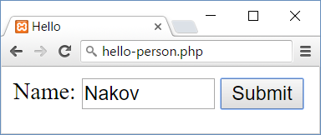
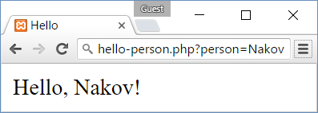
Submitting HTML Forms
HTML forms submit data to some URL
hello-person.php
<form>
Name: <input type="text" name="person" />
<input type="submit" />
</form>
hello-person.php?person=some_value

Slide 15
HTML Forms and PHP: Hello, Person!
<?php
if (isset($_GET['person'])) {
$person = htmlspecialchars($_GET['person']);
echo "Hello, $person!";
} else {
?>
<form>
Name: <input type="text" name="person" />
<input type="submit" />
</form>
<?php } ?>
If the 'person' HTTP GET parameter exists, print a greeting
Otherwise, show a HTML form to enter a person
Check your solution here: https://judge.softuni.bg/Contests/Practice/Index/235#3

Slide 16
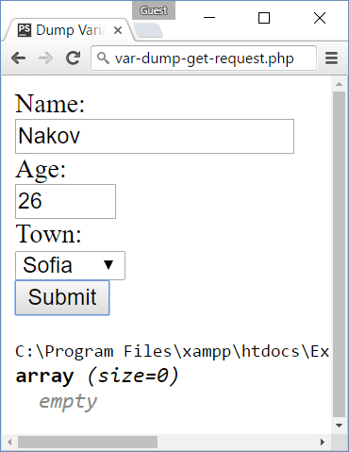
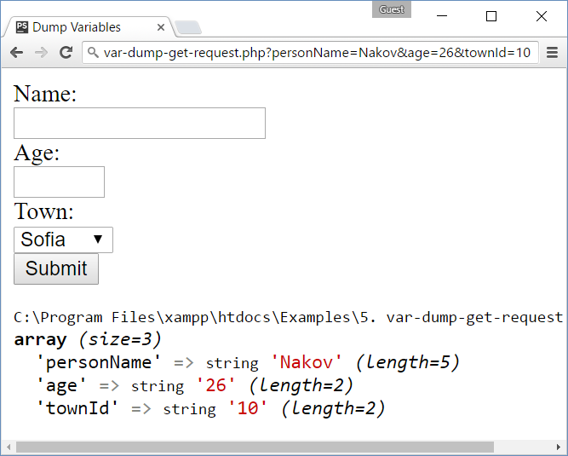
Problem: Dump a HTTP GET Request
Write a PHP script to dump the content of the HTTP GET request parameters using var_dump(…)

Slide 17
Solution: Dump a HTTP GET Request
<form>
<div>Name:</div><input type="text" name="personName" />
<div>Age:</div><input type="number" name="age" />
<div>Town:</div>
<select name="townId">
<option value="10">Sofia</option>
<option value="20">Varna</option>
<option value="30">Plodvid</option>
</select>
<div><input type="submit" /></div>
</form>
<?php var_dump($_GET); ?>
All parameters will be passed as string values in $_GET[] array
Dump the $_GET[] array
Check your solution here: https://judge.softuni.bg/Contests/Practice/Index/235#4

Slide 18
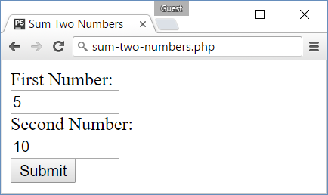
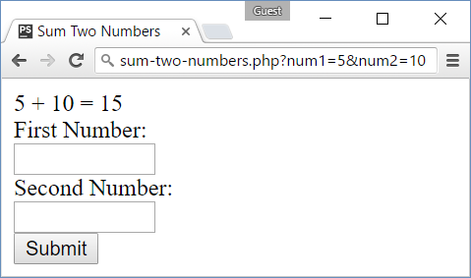
Problem: Sum Two Numbers
Write a PHP script to sum two numbers
The script should display a HTML form to enter the numbers
If the numbers are passed as parameters, display their sum

Slide 19
Solution: Sum Two Numbers
<?php if (isset($_GET['num1']) && isset($_GET['num2'])) {
$num1 = intval($_GET['num1']);
$num2 = intval($_GET['num2']);
$sum = $num1 + $num2;
echo "$num1 + $num2 = $sum";
} ?>
<form>
<div>First Number:</div>
<input type="number" name="num1" />
<div>Second Number:</div>
<input type="number" name="num2" />
<div><input type="submit" /></div>
</form>
Sum the 'num1' and 'num2' values if exist
Show a HTML form to submit num1 and num2
Check your solution here: https://judge.softuni.bg/Contests/Practice/Index/235#5

Slide 20

Summary
PHP is a server-side scripting language
Variables are prefixed by $, not declared
PHP supports classical if-else statements
PHP supports classical loop structures:
while , do-while , for, foreach
HTML forms send data as HTTP GET request
Access HTTP GET parameters from PHP using $_GET['param_name']

Slide 21








First Steps in PHP
https://softuni.bg/courses/software-technologies

Slide 22
License
This course (slides, examples, demos, videos, homework, etc.) is licensed under the "Creative Commons Attribution-NonCommercial-ShareAlike 4.0 International" license

Slide 23






Free Trainings @ Software University
Software University Foundation – softuni.org
Software University – High-Quality Education, Profession and Job for Software Developers
softuni.bg
Software University @ Facebook
facebook.com/SoftwareUniversity
Software University @ YouTube
youtube.com/SoftwareUniversity
Software University Forums – forum.softuni.bg

